Slide 1

NAAN MUDHALVAN PROJECT

Slide 2
PROJECT TITTLE
ShopEZ: Ecommerce Website Using
MERN STACK
Team Members
Muthuraj M
Nilesh A
Nithish
Muthuvel M

Slide 3
Introduction
In today’s fast-paced digital world, the e-commerce landscape is evolving rapidly, transforming how consumers shop and businesses operate. ShopEZ is an innovative e-commerce application designed to enhance the online shopping experience by offering a user-friendly platform that connects consumers with a diverse range of products and services.
With the growing demand for convenience and personalization in shopping, ShopEZ aims to address these needs by providing a seamless interface that allows users to browse, compare, and purchase items effortlessly. Our application leverages advanced technologies, including AI-driven recommendations, secure payment gateways, and efficient logistics solutions, to ensure a smooth and enjoyable shopping experience.

Slide 4
Project Goals
User-Centric Design:
Develop an intuitive and visually appealing interface that enhances user experience, making navigation and product discovery Seamless for all users.
Diverse Product Range:
Curate a wide variety of products across multiple categories, ensuring that users can find everything they need in one place, from electronics to fashion.
Personalized Shopping Experience:
Implement AI-driven recommendation algorithms to provide personalized product suggestions based on user preferences and browsing history.

Slide 5
Technology Stack
MongoDB
Type: NoSQL Database
Express.js
Type: Web Application Framework
React
Type: Frontend Library
Node.js
Type: JavaScript Runtime

Slide 6
Features Overview
User Features
User Registration and Profile Management
Account Creation: Users can easily create accounts using email, phone numbers, or social media logins.
Product Search and Filtering
Search Bar: A robust search feature allows users to quickly find products by keywords.
Admin Features
Dashboard Overview
Analytics Dashboard: A comprehensive dashboard displaying key metrics such as total sales, user registrations, popular products, and inventory levels.
User Management
User Accounts: Admins can view, edit, and deactivate user accounts as needed, ensuring proper user management.

Slide 7
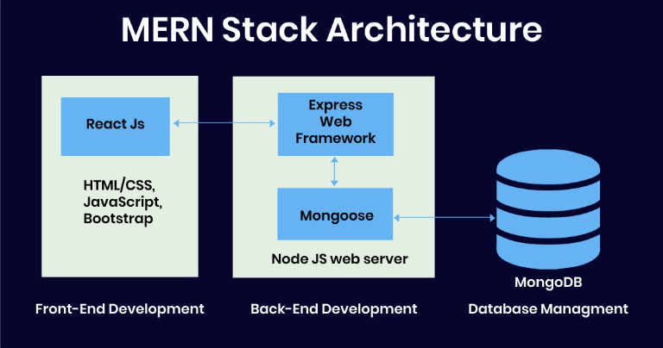
Architecture Diagram

Slide 8
Frontend Architecture
COMPONENTS:
Frontend Components
User Interface (UI)
Homepage: Engaging layout featuring banners, promotions, and featured products.
User Authentication
Login/Registration Forms: Secure forms for user account creation and login.
Responsive Design
Mobile Optimization: A design that adapts to different screen sizes, ensuring a consistent experience across devices.

Slide 9
Backend Architecture
Database (MongoDB)
User Data Storage: Secure storage of user profiles, order histories, and payment information. 2.Server (Node.js)
API Development: RESTful APIs to handle requests between the frontend and backend.
Middleware: Custom middleware for authentication, error handling, and logging.
Payment Processing
Payment Gateway Integration: Secure integration with payment processors (e.g., Stripe, PayPal) for handling transactions.

Slide 10
CHALLENGES:
Market Competition
Overview: The e-commerce market is saturated with established players.
Challenge: Differentiating ShopEZ from competitors and attracting a loyal customer base.
User Experience (UX) Design
Overview: Creating an intuitive and engaging interface is crucial.
Challenge: Balancing aesthetics with functionality and ensuring seamless navigation across devices.
Performance Optimization
Overview: Fast load times and responsiveness are vital for user satisfaction.
Challenge: Managing large volumes of data and traffic while maintaining application speed.

Slide 11

Prototype

Slide 12
CONCLUSION:
In conclusion, the development of the ShopEZ e-commerce application represents a significant step toward providing an enhanced online shopping experience tailored to modern consumer needs. By leveraging the MERN stack, we have created a robust and scalable platform that prioritizes user experience, security, and efficient operations.
The application’s diverse features—ranging from personalized recommendations to seamless payment processing—are designed to not only attract new users but also foster loyalty among existing customers. The challenges faced throughout the development process have provided valuable insights that will guide ongoing improvements and adaptations to market demands.

Slide 13
THANK YOU!!

